Slide 1
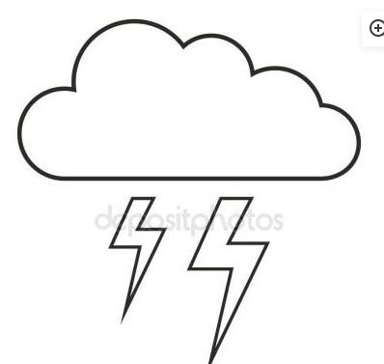
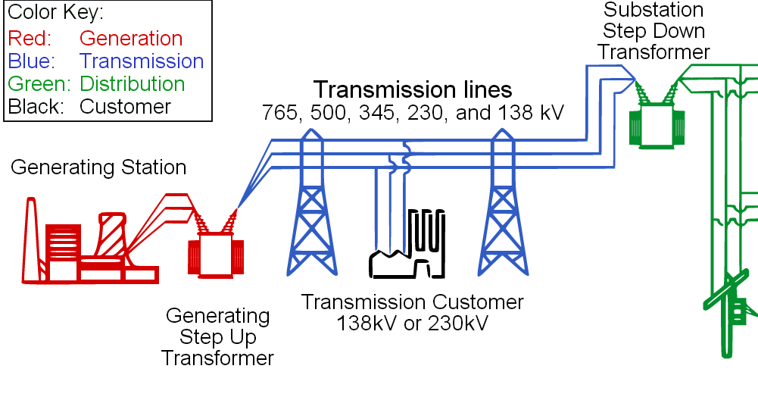

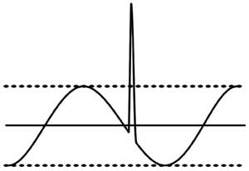
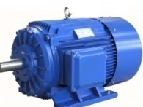
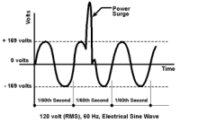
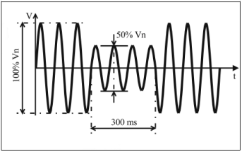
Power flow diagram from Generating Station to Wall socket
Lightning
Lab 1
Lab 2
Spike
Lab 3
Motor
Surge Voltage
Sag Voltage

Slide 2
Common power problems
Power
Disturbances
Effects on Computer System
Wave form
Loss of Data,
Shut down,
Restart of a system
Voltage Sag
Tripping of system,
System damage,
System life reduced
Voltage Surge
Loss of data,
System damage,
System life reduced
Voltage Spike

Slide 3
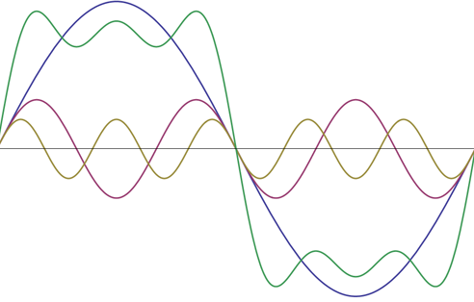
Common power problems
Power
Disturbances
Effects on Computer System
Wave form
Loss of Data,
Shut down
Blackout
Tripping of system,
System Shutdown,
System life reduced
Brownout
Loss of data,
Over heating system
System life reduced
Harmonics

Slide 4
UPS
UNINTERRUPTIBLE POWER SUPPLY

Slide 5
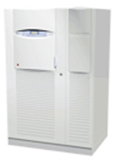
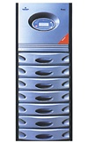
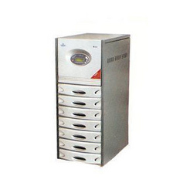
UNINTERRUPTIBLE POWER SUPPLY
An uninterruptible power supply, UPS is an electrical apparatus that provides emergency power to a load when the input power source fails. It provides instantaneous protection from input power interruptions by means of one or more attached batteries and associated electronic circuitry.

Slide 6
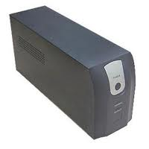
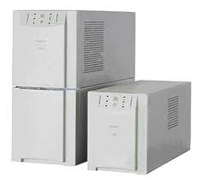
Types of UPS
Offline UPS
Line Interactive UPS
Online UPS

Slide 7
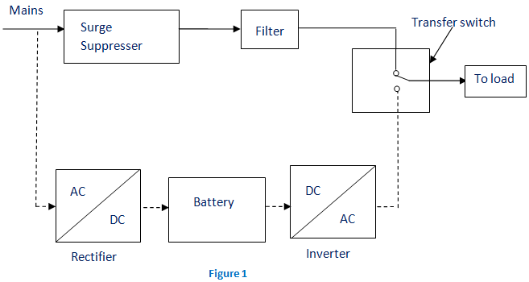
Off Line UPS

Slide 8
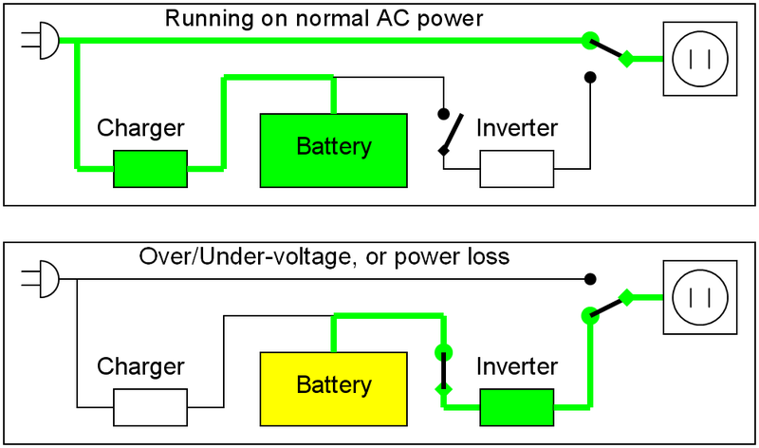
Off Line UPS

Slide 9
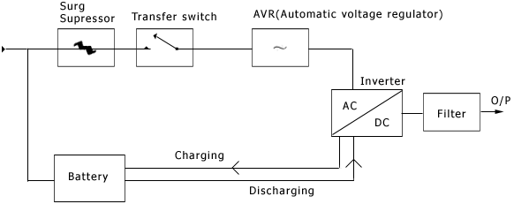
Line Interactive UPS

Slide 10
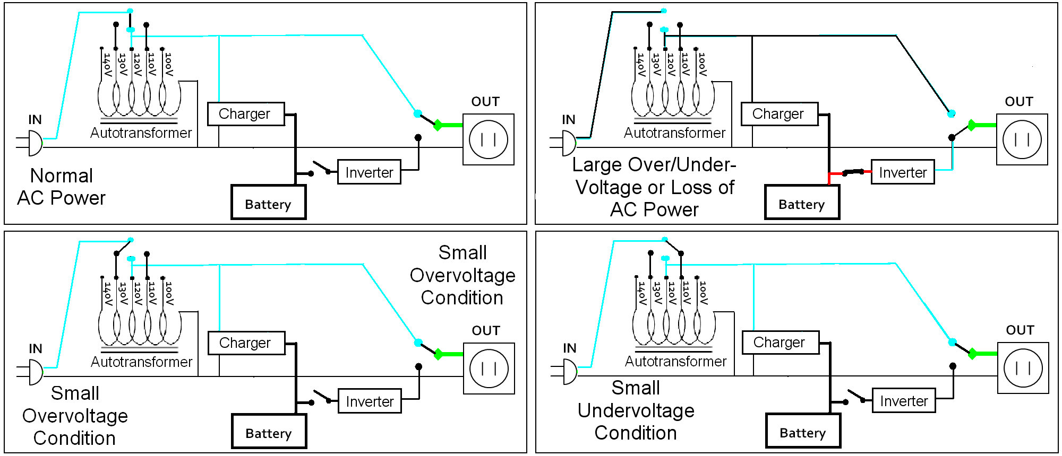
Line Interactive UPS
Normal Condition

Slide 11
Line Interactive UPS
Over voltage Condition

Slide 12
Line Interactive UPS
Under voltage Condition

Slide 13
Line Interactive UPS
Blackout Condition

Slide 14
On Line UPS
Q3 (Maintenance Bypass)
Q2 (Bypass)
O/P
Q1 (I/P)
AC
DC
DC
AC
AC
AC
AC
I/P
Q4 (O/P Switch)
Rectifier /
Charger
Inverter
Transfer
Switch
Battery

Slide 15
UPS load Calculation
Step 1: Add up the nameplate power of the anticipated loads.
Step 2: Multiply the anticipated VA number by 0.9 to estimate the actual power, in watts, that the critical load will represent.
Step 3: Divide the number by 1,000 to establish the kilowatt (kW) load level of the anticipated critical load.
Example:
Server | VDI Servers : Boston x86 Server SuperChassis 825TQ-R740LPB
Quantity | 22 Nos
Maximum Power Consumed by each node | 740 Watts
Total Power Consumed (Max) | 16.28 Kwatts
Power Facor of server Power Supply | 0.9
Load to UPS (Max) | 18 KVA

Slide 16
Backup time Calculation
Battery Voltage | Capacity (AH) | No of Batteries | Battery Bank Voltage | Efficiency of UPS | Load (KW) | Backup Time
12 V | 200 | 34 | 12 X 34 = 408V | 80 % | 80 KW | 0.8 Hours = 49 Minutes
Backup Time = (Battery Vtg * AH * No of Batteries * Efficiency)/Load in Watts
Backup time = (12v * 200AH * 34 * 0.8)/80,000W
= 0.816 Hours or 49 Minutes

Slide 17
Power Distribution Layout at Computer Division (Ground Floor)
3 Φ 415 V ~
From Sub Station
Load Details
UPS-1 - 5KVA
UPS-2 - 4KVA
UPS-3 - 7KVA
UPS-4 - 4.3KVA
UPS-5 - 6KVA
Input Panel – 1
Class IV
Input Panel – 2
Class III (DG Backup)
I/P UPS
I/P UPS 4
I/P UPS 2
I/P UPS 3
I/P UPS 5
I/P UPS 1
Emerson
30 KVA
I/P 415V ~
O/P 415V~
Worktation
Emerson
20 KVA
I/P 415V ~
O/P 230 V~
Emerson
20 KVA
I/P 415V ~
O/P 230 V~
Emerson
20 KVA
I/P 415V ~
O/P 230 V~
Emerson
20 KVA
I/P 415V ~
O/P 230 V~
Int.& Email
Emerson
20 KVA
I/P 415V ~
O/P 230 V~
Disaster Recovery
DB
at Backbone
Room
DB
Output of UPS4
DB
Output of UPS1
DB
Output of UPS4
DB - 1
VDI Servers Rack
CORE Switch
Workstation
Rack 2 (EID servers)
Bull Nova Master Node
Rack 3 (Everrun server)
Rack 4 (SMP servers)
DAE Grid
I/O room peripherals
OLAP, DFIS, APAR
HPC Fire, PVelite
Xeon Server1 & 2
Workstations
I/O Room (spare)
HPC Network Rack
VDI Servers Rack
Rack 1
(OPA,lic,FW,LDAP)
Rack 2
(EID servers)
Rack 4
(SMP servers)
VDI Servers Rack
DB - 2
Internet Setup
Email Server
Anunet Setup
Web Servers

Slide 18
IVY CLUSTER POWER DISTRIBUTION LAYOUT
COMPUTER CENTRE ANNEX FLOOR II PCC
1600A TP ACB CLASS IV
SERVER DISTRIBUTION PANEL – 1
400A TPN SFU
SERVER DISTRIBUTION PANEL – 2
400A TPN SFU
MCB1 63A 4P
FLDB 4*2P 32A
RACK 9
MCB1 63A 4P
FLDB 4*2P 32A
RACK 1,TEST RACK
MCB2 63A 4P
FLDB 4*2P 32A
RACK 10
MCB2 63A 4P
FLDB 4*2P 32A
RACK 2
MCB3 63A 4P
FLDB 4*2P 32A
RACK 11
MCB3 63A 4P
FLDB 4*2P 32A
RACK 3 SPARE
MCB4 63A 4P
FLDB 4*2P 32A
RACK 12
MCB4 63A 4P
FLDB 4*2P 32A
RACK 6
MCB5 63A 4P
FLDB 4*2P 32A
RACK 13
MCB5 63A 4P
FLDB 4*2P 32A
RACK 7
MCB6 63A 4P
FLDB 4*2P 32A
RACK 14
MCB6 63A 4P
FLDB 4*2P 32A
RACK 8
MCB7 63A 4P
FLDB 4*2P 32A
RACK 15
MCB7 63A 4P
SPARE
Head, Management
Console Monitors
MCB8 63A 4P
FLDB 4*2P 32A
RACK 16
MCB8 63A 4P
SPARE
MCB9 63A 4P
UPS 4
FLDB 4*2P 32A
MCB9 63A 4P
UPS 3
FLDB 4*2P 32A
MCB10 63A 4P
SPARE
RACK 9
MCB10 63A 4P
SPARE
RACK 4
RACK 5

Slide 19
Rack 3
Pie nodes
Compute nodes
INCOMER FROM PCC ROOM
CLASS III PANEL
Load Details
UPS-1 - 2.3KVA
UPS-2 - 6.3KVA
UPS-3 - 6.6KVA
UPS-4 - 3.2KVA
Rack 4
Head 2
IB Switch
VDB 1
125A 4P MCB
Rack 5
Head 1
MDS1,2
OSS1,2,3,4
UPS 1
UPS 2
Rack 9
Management
Tape Library
FLDB 4*2P 32A
FLDB 4*2P 32A
RACK 4
RACK 5
RACK 3
KMS RACK

Slide 20
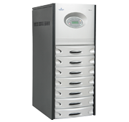

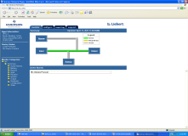
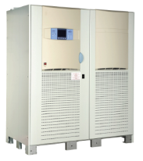
Remote Monitoring of UPS
Annex building
1st floor
1
2
3
4
Operator sitting area
20KVA UPS’s
1
2
Network
120 KVA UPS’s
Annex building
Ground floor

Slide 21

Remote Monitoring of UPS
Normal operation of UPS.

Slide 22
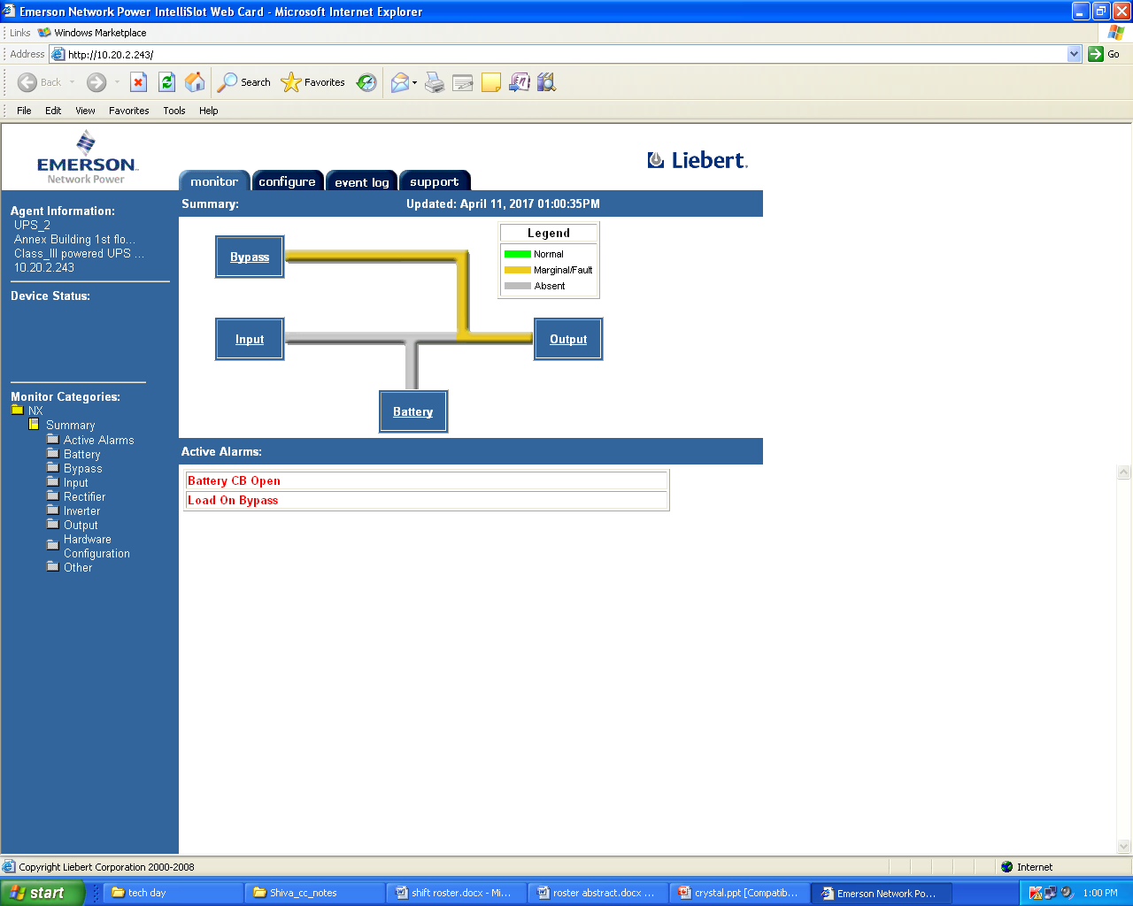
Remote Monitoring of UPS
UPS in bypass mode.

Slide 23


Slide 24
Thank you

